Slide 1
Design and Analysis of Algorithms (UE18CS251)
Unit I - Analysis Framework
Mr. Channa Bankapur
channabankapur@pes.edu

Slide 2
What does it return?
foo(n)
ctr ← 0
for i ← 1 to n
ctr ← ctr + 1
return ctr
Return value: …

Slide 3
What does it return?
foo(n)
ctr ← 0
for i ← 1 to n
ctr ← ctr + 1
return ctr
Return value: n
Algorithm SeqSearch(A[0..n-1], key)
for i ← 0 to n-1
if (A[i] = key)
return i
return -1
How many times “A[i] = key” comparison is made?
foo() exhibits the structure of SeqSearch(). Return value of foo(), the number of times the operation “ctr+1” in foo() executes and the number of times the operation “A[i] = key” in SeqSearch() executes are all the same. This count plays a key role in the running time analysis of the algorithm.

Slide 4
What does it return?
foo(n)
ctr ← 0
for i ← 1 to n
for j ← 1 to n
ctr ← ctr + 1
return ctr
Return value: …

Slide 5
BSort(A[0..n-1])
for k ← 0 to n-2
for i ← 0 to n-2
if(a[i] > a[i+1])
Swap(a[i],a[i+1])
How many times “A[i] > A[i+1]” comparison is made?
What does it return?
foo(n)
ctr ← 0
for i ← 1 to n-1
for j ← 1 to n-1
ctr ← ctr + 1
return ctr
Return value: (n-1)²
(the product rule)

Slide 6
What does it return?
foo(n, m)
ctr ← 0
for i ← 1 to n
for j ← 1 to m
ctr ← ctr + 1
return ctr
Return value: …

Slide 7
What does it return?
foo(n, m)
ctr ← 0
for i ← 1 to n
for j ← 1 to m
ctr ← ctr + 1
return ctr
Return value: nm
(The number of character comparisons in the worst-case in the Naive String Matching algorithm is same as that of the “ctr+1” operation here)

Slide 8
What does it return?
foo(n₁, n₂, …, n_{m})
k ← 0
for i₁ ← 1 to n₁
for i₂ ← 1 to n₂
.
.
for i_{m} ← 1 to n_{m}
k ← k + 1
return k
Return value: …

Slide 9
What does it return?
foo(n₁, n₂, …, n_{m})
k ← 0
for i₁ ← 1 to n₁
for i₂ ← 1 to n₂
.
.
for i_{m} ← 1 to n_{m}
k ← k + 1
return k
Return value: n₁ * n₂ * ... * n_{m}
(the generalized product rule)

Slide 10
What does it return?
foo(n)
ctr ← 0
for i ← 1 to n-1
for j ← i+1 to n
ctr ← ctr + 1
return ctr
Return value: …

Slide 11
What does it return?
foo(n)
ctr ← 0
for i ← 1 to n - 1
for j ← i + 1 to n
ctr ← ctr + 1
return ctr
ctr: (n-1) + (n-2) + (n-3) + … + 1 = n * (n-1) / 2.
ctr: n choose 2.
SelectionSort(A[0..n-1])
for i ← 0 to n-2
min ← i
for j ← i+1 to n-1
if(A[j]<A[min])
min ← j
Swap (A[i],A[min])
How many times “A[j] > A[min]” comparison is made?

Slide 12
What does it return?
foo(n)
ctr ← 0
for i ← 1 to n - 1
for j ← i + 1 to n
ctr ← ctr + 5
return ctr
Return value:
C(n) = 5* ((n-1) + (n-2) + … + 1)
= 5 * n * (n-1) / 2

Slide 13
What does it return?
foo(n)
if(n=1) return 1
k ← foo(n-1)
k ← k+1
k ← k + foo(n-1)
return k
Return value: …

Slide 14
What does it return?
foo(n)
if(n=1) return 1
k ← foo(n-1)
k ← k+1
k ← k + foo(n-1)
return k
C(n) = 1 + 2 C(n-1), C(0)=0
= 1 + 2(1+2C(n-2))
= 1+2+2²C(n-2)
= 2⁰+2¹+2²+2³C(n-3)
= 2⁰+...+2^{i-1}+2^{i}C(n-i)
n-i = 0 ⇒ i = n
C(n) = 2⁰+...+2^{n-1}+2^{n}C(0)
C(n) = 2^{n} - 1
Hanoi(n, Src, Dest, Aux)
if (n = 0) return
Hanoi(n-1,Src,Aux,Dst)
Move disk#n from S to D
Hanoi(n-1,Aux,Dst,Src)
return
How many times “Move disk” operation is executed?
Count: 2^{n} - 1

Slide 15
What does it return?
foo(n)
k ← 0
i ← n
while (i > 1)
k ← k + 1
i ← ⌊i/2⌋
return k
Return value: …
foo(n)
k ← 0
if(n > 1)
k ← foo(⌊n/2⌋)+1
return k

Slide 16
What does it return?
foo(n)
k ← 0
if(n > 1)
k←foo(⌊n/2⌋)+1
return k
C(n) = C(⌊n/2⌋) + 1
, C(1) = 0
C(n) = ⌊log₂n⌋
BSch(A[l..r], k)
if(r-l+1 < 1)
return -1
m = ⌊(l+r) / 2⌋
if(k = A[m])
return m
else if(k < A[m])
return BSch(A[l..m-1],k)
else
return BSch(A[m+1..r],k)
How many times “k = A[m]” comparison is made?

Slide 17
What does it return?
foo(n)
k ← 0
i ← n
while (i > 1)
j ← 1
while (j ≤ n)
k ← k + 1
j ← j + 1
i ← ⌊i/2⌋
return k
Return value: …

Slide 18
What does it return?
foo(n)
k ← 0
i ← n
while (i > 1)
j ← 1
while (j ≤ n)
k ← k + 1
j ← j + 1
i ← ⌊i/2⌋
return k
Return value: n * log₂n
(Element-to-element comparison in Merge Sort is comparable to “k←k+1” here)

Slide 19
What does it return?
foo(str)
k ← 0
n ← length(str)
for each permutation of str
j ← 1
while (j ≤ n)
k ← k + 1
j ← j + 1
return k
Return value: …

Slide 20
What does it return?
foo(str)
k ← 0
n ← length(str)
for each permn of str
j ← 1
while (j ≤ n)
k ← k + 1
j ← j + 1
return k
Return value: n * n!
Travelling Salesman Problem
mincost ← INFINITY
for each perm of n cities
cost ← 0
for each edge in the H_ckt
cost ← cost + edgeCost
if(cost < mincost)
mincost ← cost
return mincost
How many times “cost + edgeCost” addition is made?

Slide 21
Measuring an Input’s Size:
An algorithm takes same or more time for a larger input of similar kind.
Algorithm’s efficiency is measured as a function of its input size.
Eg:
n: size of the array for SequentialSearch(A[0..n-1], K) and SelectionSort(A[0..n-1]).
(m, n, p): for MatrixMultiplication(A[m,n], B[n,p]) of two matrices of order mxn and nxp.
n (or number of bits used to represent n = ⌊log₂n⌋ + 1): the value of the input number in BinaryDigits(n).

Slide 22
Units for Measuring Running Time:
Count in seconds, minutes, etc. -- Standard unit of time measurement. An algorithm may take different time based on
speed of the computing device
implementation of the algorithm
compiler optimization
Count the number of times each of the algorithm’s operations is executed.
difficult to count each of them
not all of them are similar in running time

Slide 23
Count the number of times each of the algorithm’s operations is executed.
Algorithm SelectionSort(A[0..n-1])
for i ← 0 to n-2
min ← i
for j ← i+1 to n-1
if(A[j] < A[min]) min ← j
Swap A[i] with A[min]
return A

Slide 24
Count the number of times each of the algorithm’s operations is executed.
Algorithm SelectionSort(A[0..n-1])
i ← 0 1
while(i ≤ n-2) 1 + n-1
min ← i n-1
j ← i+1 n-1
while(j ≤ n-1) n-1 + n(n-1)/2
if(A[j] < A[min]) n(n-1)/2
min ← j n(n-1)/2
j ← j+1 n(n-1)/2
Swap A[i] with A[min] n-1
i ← i+1 n-1

Slide 25
Count the number of times each of the algorithm’s operations is executed.
Algorithm SelectionSort(A[0..n-1])
i ← 0 (1) * c₁
while(i ≤ n-2) (1 + n-1) * c₂
min ← i (n-1) * c₃
j ← i+1 (n-1) * c₄
while(j ≤ n-1) (n-1 + n(n-1)/2) * c₅
if(A[j] < A[min]) (n(n-1)/2) * c₆
min ← j (n(n-1)/2) * c₇
j ← j+1 (n(n-1)/2)* c₈
Swap A[i] with A[min] (n-1) * c₉
i ← i+1 (n-1) * c₁₀

Slide 26
Count the number of times each of the algorithm’s operations is executed.
Algorithm SelectionSort(A[0..n-1])
i ← 0 (1) * (c₁+c₂)
while(i ≤ n-2)
min ← i (n-1) * (c₂+c₃+c₄+c₅+c₉+c₁₀)
j ← i+1
while(j ≤ n-1)
if(A[j] < A[min]) (n(n-1)/2) * (c₅+c₆+c₇+c₈)
min ← j
j ← j+1
Swap A[i] with A[min]
i ← i+1

Slide 27
Count the number of times each of the algorithm’s operations is executed.
Algorithm SelectionSort(A[0..n-1])
i ← 0 (1) * c₁₁
while(i ≤ n-2)
min ← i (n-1) * (c₁₂)
j ← i+1
while(j ≤ n-1)
if(A[j] < A[min]) (n(n-1)/2) * (c₁₃)
min ← j
j ← j+1
Swap A[i] with A[min]
i ← i+1

Slide 28
Count the number of times each of the algorithm’s operations is executed.
Algorithm SelectionSort(A[0..n-1])
i ← 0 ≤ (n(n-1)/2) * c₁₁
while(i ≤ n-2)
min ← i ≤ (n(n-1)/2) * (c₁₂)
j ← i+1
while(j ≤ n-1)
if(A[j] < A[min]) = (n(n-1)/2) * (c₁₃)
min ← j
j ← j+1
Swap A[i] with A[min]
i ← i+1
T(n) ≤ (n(n-1)/2) * c₁₄ , where one basic operation like
A[j] < A[min] executes for (n(n-1)/2) times.

Slide 29
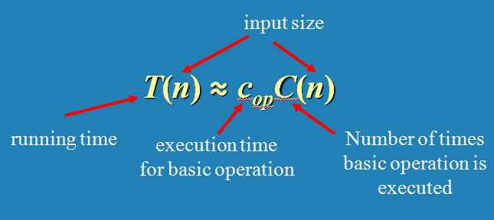
Basic Operation: The most important operation of the algorithm, which is contributing the most to the total running time.
Time efficiency: Counting the number of times the algorithm’s basic operation is executed on inputs of size n.

Slide 30
T(n) ≅ c_{op} * C(n)
How much longer will the Selection Sort algorithm run if the input size is doubled or increased 10-fold?
For Selection Sorting algorithm,
C(n) = (n(n-1)/2)
= (n² /2 - n/2)
≅ n²/2 for sufficiently large value of n.

Slide 31

C(n) ≅ n²/2 for sufficiently larger value of n.
For n=1,000 → T(n) ≅ 2 milliseconds
For n=10,000 → T(n) ≅ 200 ms = 0.2 seconds
For n=100k → T(n) ≅ 0.2*100 = 20 seconds

Slide 32
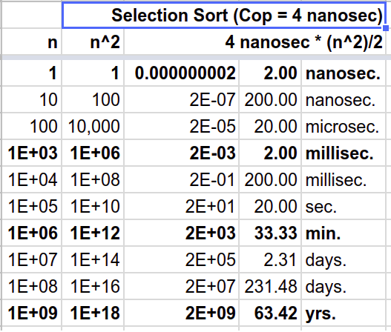

Slide 33
Analysis Framework ignores multiplicative constants and concentrates on the basic operation count’s order of growth to within a constant multiple for large-size inputs. So, the order of growth of selection sort is primarily driven by “n²”.
In the same way, let the order of growth of Mergesort is driven by “n log n”. Suppose, the cost of the basic operation of the selection sort is 2 nanoseconds and that of the mergesort is 40 nanoseconds. What could be the estimated execution time of mergesort on an input size of:
(i) 1 million?
(ii) 1 billion?

Slide 34
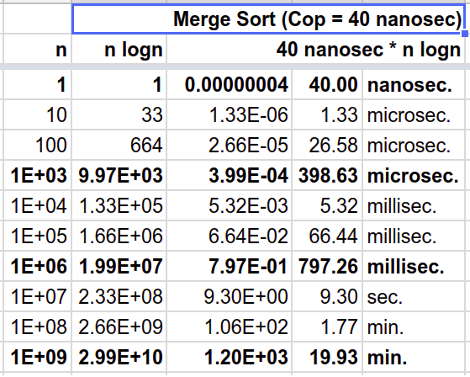

Slide 35
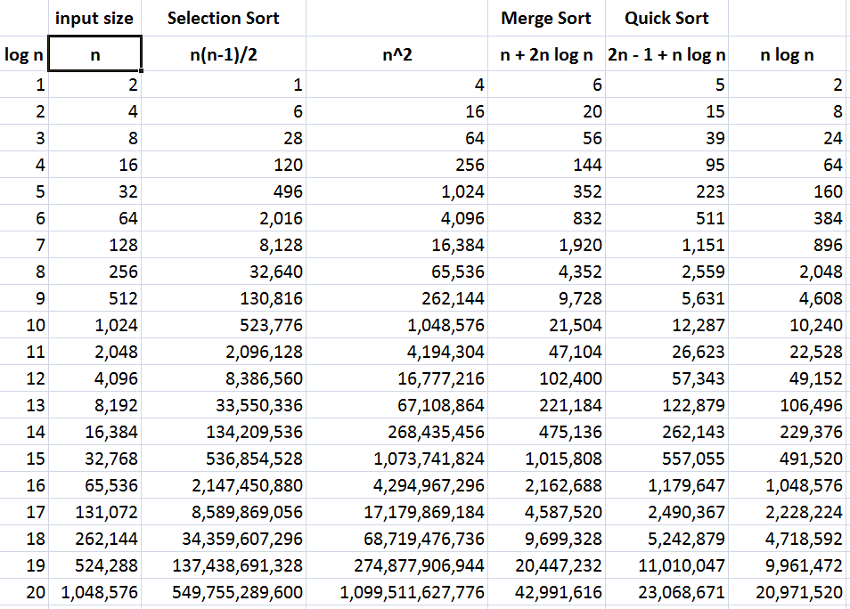

Slide 36
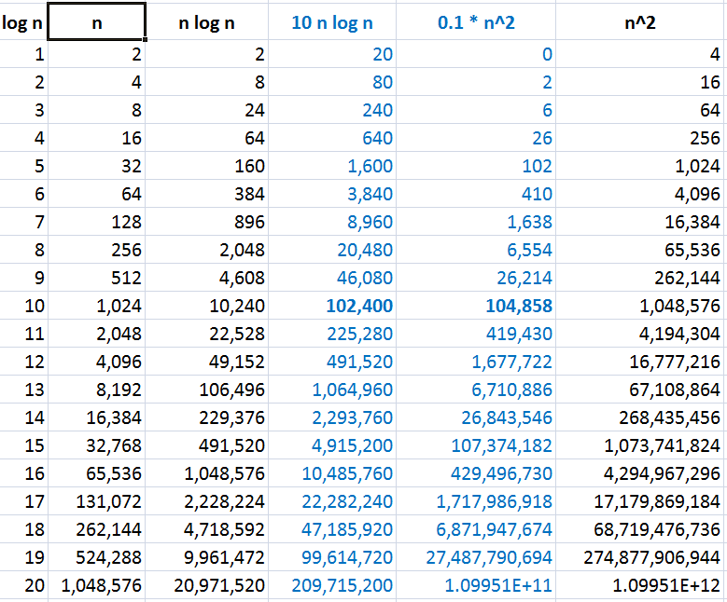

Slide 37
What if the basic operation runs for 2¹⁰⁰ times?
Suppose,
An algorithm takes 2¹⁰⁰ operations.
Tower of Hanoi takes about 2¹⁰⁰ operations for 100 disks.
Each operation takes just one clock tick.
1 terahertz processor exists. (10¹² ≅ 2⁴⁰)
So, the algorithm takes 2¹⁰⁰ / 2⁴⁰ = 2⁶⁰ seconds.
≅ 2³⁵ years (∵ 1 year = 60*60*24*365 ≅ 2²⁵ seconds)
≅ 32 * 10⁹ years (∵ 10⁹ ≅ 2³⁰)
= 32 billion years
BTW, it’s estimated that the Earth was formed about 4.5 billion years back and the big bang happened about 14 billion yrs back!
Algorithms that require an exponential number of operations are practical for solving only problems with very small input sizes.

Slide 38
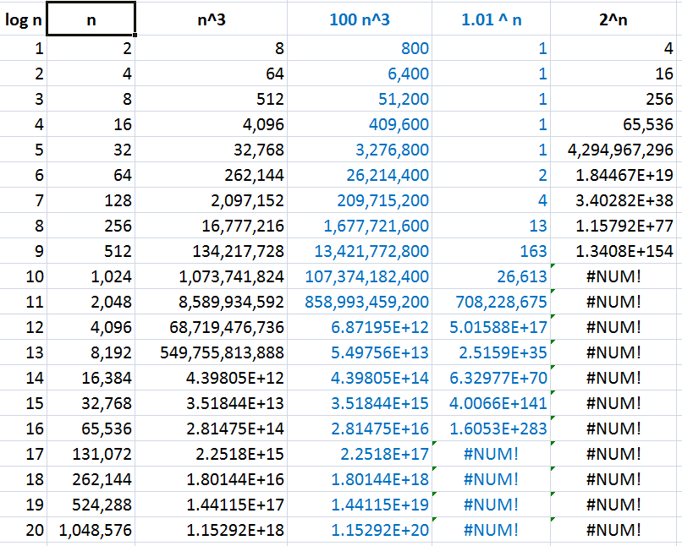

Slide 39
A Problem can be:
Non-computable
No solution exists theoretically
Computable and Intractable
Solution exists, but …
exponential time (aka super-polynomial time)
Computable and Tractable
polynomial time

Slide 40
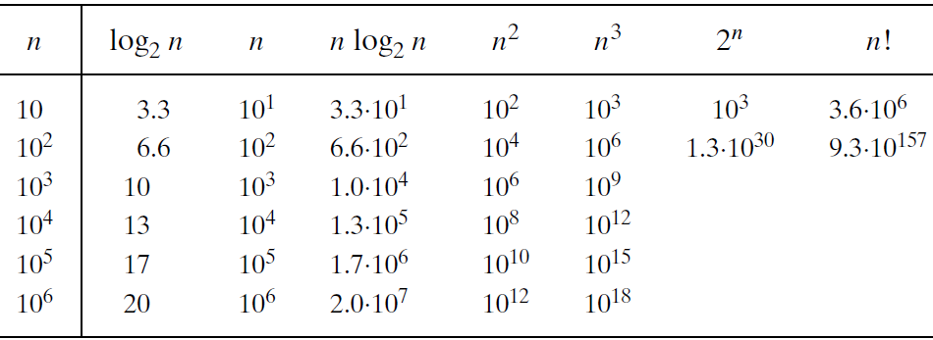
Orders of growth:

Slide 41
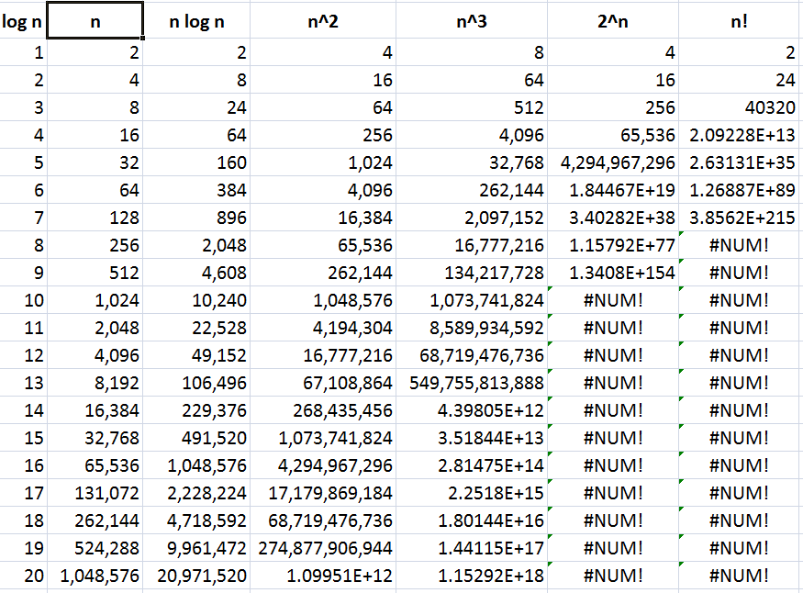

Slide 42
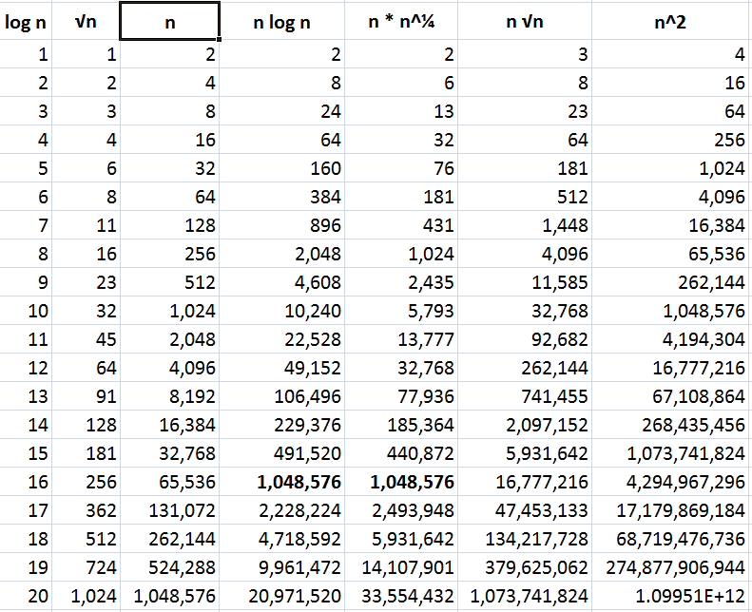

Slide 43
There are many algorithms for which running time depends not only on an input size but also on the specifics of a particular input.
Algorithm SequentialSearch(A[0..n-1], K)
//Outputs the index of the first element of A that
// matches K or -1 if there are no matching elements.
i ← 0
while (i < n) and (A[i] ≠ K) do
i ← i + 1
if (i < n) return i
return -1

Slide 44
Algorithm SequentialSearch(A[0..n-1], K)
//Outputs the index of the first element of A that
// matches K or -1 if there are no matching elements.
i ← 0
while (i < n) and (A[i] ≠ K) do
i ← i + 1
if (i < n) return i
return -1
Input size: n.
Basic Operation: (i < n) and (A[i] ≠ K)
C_{worst}(n) = n+1
C_{best}(n) = 1
C_{avg}(n) = ?

Slide 45
Worst case: C_{worst}(n) – maximum over inputs of size n
Best case: C_{best}(n) – minimum over inputs of size n
Average case: C_{avg}(n) – “average” over inputs of size n
Number of times the basic operation will be executed on typical input
NOT the average of worst and best case
Amortized efficiency (out of syllabus)

Slide 46
Algorithm SequentialSearch(A[0..n-1], K)
If the search key is certainly present in the array:
C_{avg, key present}(n) = (1 + 2 + … + n) / n
C_{avg, key present}(n) = (n + 1) / 2
C_{avg, key absent}(n) = (n + 1)
Let ‘p’ be the probability of the search key present in the array.
C_{avg}(n) = p(n + 1) / 2 + (1 - p)(n + 1)
When p = 1, C_{avg}(n) = (n + 1) / 2
When p = 0, C_{avg}(n) = (n + 1)
When p = 0.5, C_{avg}(n) = 0.75 * (n + 1)

Slide 47
Algorithm SequentialSearch(A[0..n-1], K)
Input Size: n
Basic Operation : (i < n) and (A[i] ≠ K)
C_{worst}(n) = Count of the basic operation at the max
= n + 1
C_{best}(n) = 1
C_{avg}(n) = from (n+1)/2 to (n+1) depending on the probability of search key being present in the input array.

Slide 48
Time efficiency analysis framework concentrates on the order of growth of the basic operation count of an algorithm as the principal indicator of the algorithm’s efficiency.
Asymptotic Notations:
“Big Oh” O(g(n)):
class of functions t(n) that grow no faster than g(n)
“Big Omega” Ω(g(n)):
class of functions t(n) that grow at least as fast as g(n)
“Big Theta” Θ(g(n)):
class of functions t(n) that grow at the same rate as g(n)

Slide 49
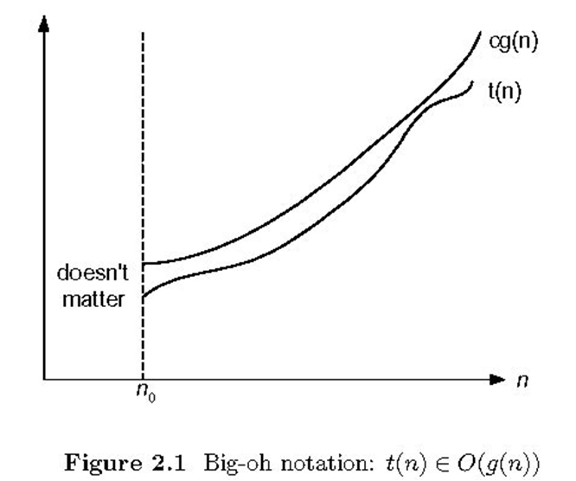
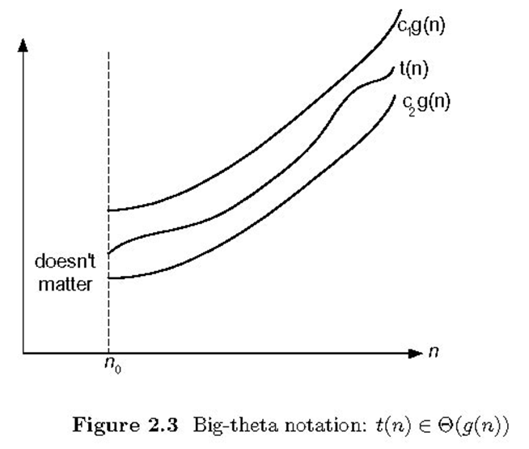
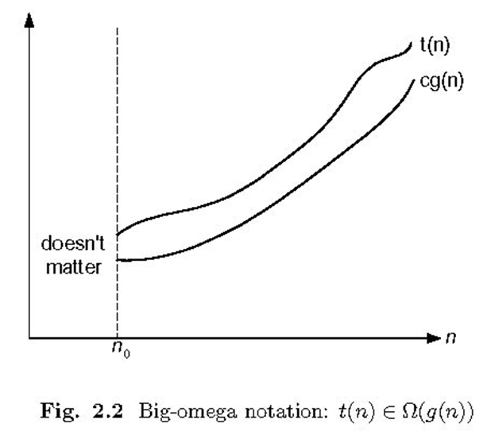

Slide 50
“Big Oh” O(g(n)):
A function t(n) is said to be in
O(g(n)) if t(n) is bounded above
by some constant multiple of
g(n) for all large n.
t(n) ≤ cg(n) ∀ n ≥ n₀
Denoted as t(n) ∈ O(g(n))
Eg: 100n+5 ∈ O(n)
100n+5 ≤ 100n+5n (∀ n≥1)
100n+5 ≤ 105n ∀ n≥1 (∴ c=105, n₀=1)
100n+5 ≤ 100n+n (∀ n≥5) = 101n ∀ n≥5 (∴ c=101,n₀=5)
Eg: 100n+5 ∈ O(n²)
Eg: n(n-1)/2 ∈ O(n²)

Slide 51
“Big Omega” Ω(g(n)):
A function t(n) is said to be in
Ω(g(n)) if t(n) is bounded below
by some constant multiple of g(n)
for all large n.
t(n) ≥ cg(n) ∀ n ≥ n₀
Denoted by t(n) ∈ Ω(g(n))
Eg: 100n+5 ∈ Ω(n)
100n+5 ≥ 100n (∀ n≥0)
100n+5 ≥ 100n ∀ n≥0 (∴ c=100, n₀=0)
Eg: n(n-1)/2 ∈ Ω(n²)
Eg: n(n-1)/2 ∈ Ω(n)

Slide 52
“Big Theta” Θ(g(n)):
A function t(n) is said to be
in Θ(g(n)) if t(n) is bounded
both above and below by
some constant multiples of
g(n) for all large n.
c₂g(n)≤ t(n) ≤ c₁g(n) ∀ n ≥ n₀
Denoted by t(n) ∈ Θ(g(n))
Eg: n(n-1)/2 ∈ Θ(n²)
n(n-1)/2 = n²/2 - n/2 ≤ n²/2 ∀ n≥0
n(n-1)/2 = n²/2 - n/2 ≥ n²/2 - n²/4 = n²/4 ∀ n≥2
n²/4 ≤ n(n-1)/2 ≤ n²/2 ∀ n≥2 (∴ c₁=1/2, c₂=1/4, n₀=2)

Slide 53
t(n) ∈ O(g(n))
Nonnegative functions defined on the set of natural numbers
t(n): algorithm’s running time by counting basic operation
g(n): simple function to compare the count with.
O(g(n)) is the set of all functions with a smaller or same order of growth as g(n).
E.g.: 100n + 5 ∈ O(n)
∈ O(n²)
∉ O(log n)
n(n-1)/2 ∈ O(n²)
∈ O(n¹⁰)
∉ O(n)

Slide 54
Ω(g(n)) is the set of all functions with a larger or same order of growth as g(n).
E.g.: 100n + 5 ∈ Ω(n)
∉ Ω(n²)
∈ Ω(log n)
n(n-1)/2 ∈ Ω(n²)
∉ Ω(n¹⁰)
∈ Ω(n)
Θ(g(n)) is the set of all functions that have the same order of growth as g(n).
E.g.: n(n-1)/2 ∈ Θ(n²)
∉ Θ(n³)
∉ Θ(n logn)

Slide 55
t(n) ∈ O(t(n))
t(n) ∈ O(g(n)) iff g(n) ∈ Ω(t(n))
t(n) ∈ Θ(g(n)) iff g(n) ∈ Θ(t(n))
If t (n) ∈ O(g (n)) and g(n) ∈ O(h(n)) , then t(n) ∈ O(h(n))
If t₁(n) ∈ O(g₁(n)) and t₂(n) ∈ O(g₂(n)) , then
t₁(n) + t₂(n) ∈ O(max{g₁(n), g₂(n)})

Slide 56
Theorem: If t₁(n) ∈ O(g₁(n)) and t₂(n) ∈ O(g₂(n)) , then
t₁(n) + t₂(n) ∈ O(max{g₁(n), g₂(n)})
That is, if
t₁(n) ≤ c₁g₁(n) ∀ n≥n₁ and t₂(n) ≤ c₂g₂(n) ∀ n≥n₂
then
t₁(n) + t₂(n) ≤ c max{g₁(n), g₂(n)} ∀ n ≥ n₀
Proof:
Hint:
W.k.t. for real numbers a₁,b₁,a₂,b₂
if a₁≤b₁ and a₂≤b₂, then a₁+a₂≤ 2 max{b₁,b₂}

Slide 57
Theorem: If t₁(n) ∈ O(g₁(n)) and t₂(n) ∈ O(g₂(n)) , then
t₁(n) + t₂(n) ∈ O(max{g₁(n), g₂(n)})
Proof:
t₁(n) ≤ c₁g₁(n) ∀ n≥n₁
t₂(n) ≤ c₂g₂(n) ∀ n≥n₂
t₁(n) + t₂(n) ≤ c₁g₁(n) + c₂g₂(n) ∀ n ≥ max{n₁,n₂}
≤ c₃g₁(n) + c₃g₂(n) where c₃= max{c₁,c₂}
≤ c₃ (g₁(n) + g₂(n))
≤ c₃ 2 max{g₁(n), g₂(n)}
Therefore, t₁(n) + t₂(n) ∈ O(max{g₁(n), g₂(n)})
where c = 2 max{c₁,c₂} and n₀ = max{n₁,n₂}

Slide 58
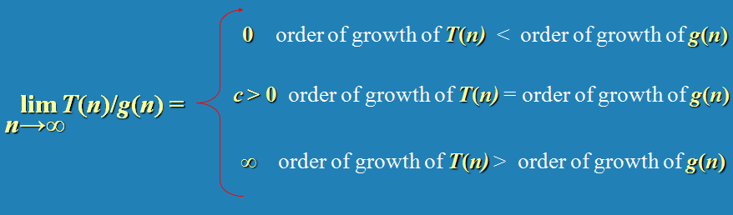
Limits are useful for comparing orders of growth of two specific functions.
Limit of the ratio of two functions reveals the relative orders of growth of the two functions.
How can we relate these three cases to
T(n) ∈ O(g(n)), T(n) ∈ Ω(g(n)) and T(n) ∈ Θ(g(n)) ?
T(n) ∈ o(g(n)), T(n) ∈ 𝛚(g(n)) ?

Slide 59


E.g.: Compare the orders of growth of n(n-1)/2 and n²

Slide 60
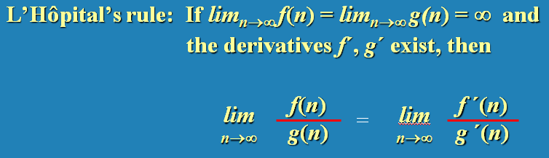


E.g.: Compare the orders of growth of log₂ n and √(n)
Little-oh notation

Slide 61

E.g.: Compare the orders of growth of n! and 2^{n}.

Slide 62
All logarithmic functions log_{a} n belong to the same class Θ(log n) no matter what base of the logarithm a > 1 is.
log₁₀ n ∈ Θ(log₂ n)
All polynomials of the same degree k belong to the same class: a_{k}n^{k} + a_{k-1}n^{k-1} + … + a₀ ∈ Θ(n^{k})
Exponential functions a^{n} have different orders of growth for different a’s.
3^{n} ∉ Θ(2^{n})

Slide 63
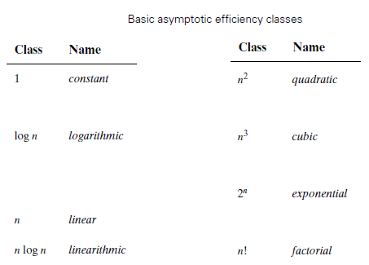

Slide 64
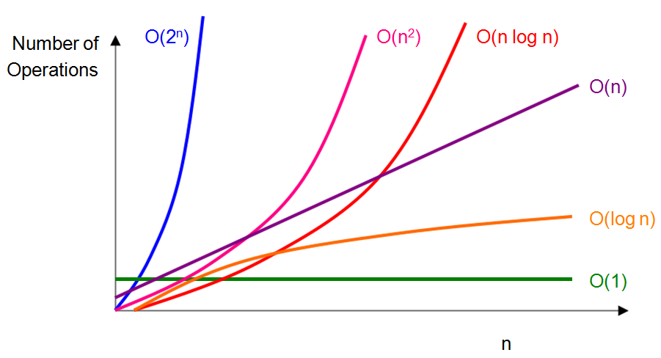
1 < log log n < log n < n^{0.001} < n^{0.5} <
n < n log n < n² < n³ < n¹⁰⁰ <
1.01^{n} < 2^{n} < 100^{n} < n! < n^{n} < …

Slide 65
Analysing time efficiency of recursive/non-recursive algorithms:
input size?
basic operation?
C_{best}(n), C_{worst}(n) and C_{avg}(n), or just C(n)?
Closed-form formula for C(n)
If C(n) is a recurrence, solve the recurrence (or, at the very least, establish its solution’s order of growth) by backward substitutions or some other method.
T(n) ∈ O(), Ω(), Θ()?

Slide 66
Algorithm SequentialSearch(A[0..n-1], K)
//Outputs the index of the first element of A that
// matches K or -1 if there are no matching elements.
i ← 0
while (i < n) and (A[i] ≠ K) do
i ← i + 1
if (i < n) return i
return -1
Input size: n.
Basic Operation: (i < n) and (A[i] ≠ K)
C_{worst}(n) = n+1 ∈ Θ(n)
C_{best}(n) = 1 ∈ Θ(1)
C_{avg}(n) = from (n+1)/2 to (n+1) ∈ Θ(n)

Slide 67
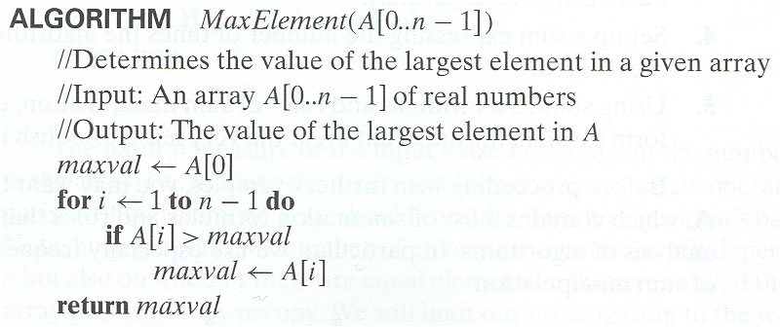
Input Size: n
Basic Operation : ( A[i] > maxval )
C_{worst}(n) = C_{best}(n) = n-1 ∈ Θ(n)

Slide 68
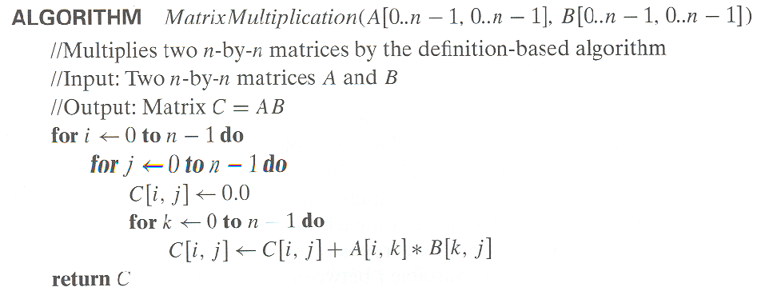
Input Size: n
Basic Operation : Multiplication (A[i,k]*B[k,j])
C_{worst}(n) = C_{best}(n) = n³ ∈ Θ(n³)

Slide 69
Array with distinct elements:
For every distinct pair of elements (A_{i} , A_{j}), A_{i} != A_{j}.
Algorithm UniqueElements(A[0..n-1])
//Determines whether all the elements in a given are distinct.
//Input: An array A[0..n-1]
//Output: Returns “true” if all the elements in A are distinct
// and “false” otherwise.
for i ← 0 n-2 do
for j ← i+1 to n-1
if(A[i] = A[j]) return false
return true

Slide 70
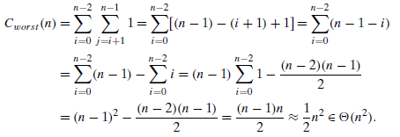
Algorithm: UniqueElements(A[0..n-1])
Input Size: n
Basic Operation : (A[i] = A[j])
C_{worst}(n) = n * (n - 1) / 2 ∈ Θ(n²)
C_{best}(n) = 1 ∈ Θ(1)

Slide 71
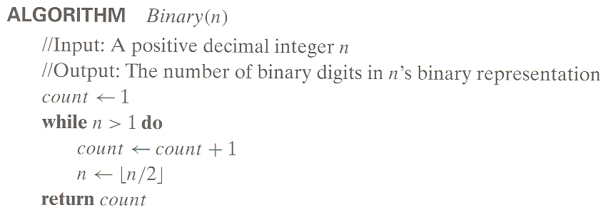
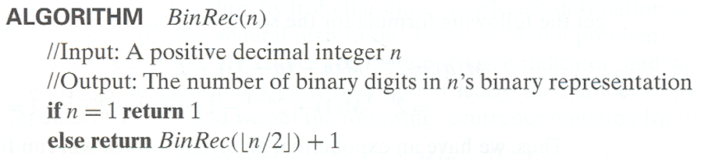
Number of bits needed to represent decimal value n:

Slide 72
Algorithm: BinaryDigits(n)
Input Size: n
Basic Operation : addition
C_{worst}(n) = C_{best}(n)
C(n) = C(n/2) + 1, C(1) = 0
= C(n/4) + 2
= C(n/2³) + 3
= C(n/2^{i}) + i
C(n/2^{i}) is C(1) when n/2^{i} = 1 ⇒ n = 2^{i} ⇒ i = log₂n
C(n) = log₂n ∈ Θ(log n)

Slide 73

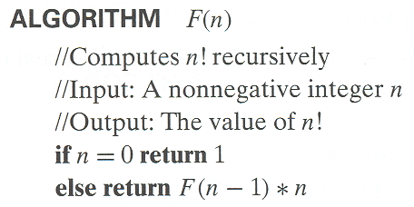
Input Size: n
Basic Operation : multiplication
C(n) = C(n - 1) + 1, C(0) = 0
= n ∈ Θ(n)
Basic Operation : (n = 0) i.e. the number calls to F(n)
C(n) = C(n - 1) + 1, C(0) = 1
= n + 1 ∈ Θ(n)

Slide 74
Algorithm TowerOfHanoi(n, Src, Aux, Dst)
if (n = 0) RETURN
Hanoi(n-1, Src, Dst, Aux)
Move disk n from Src to Dst
Hanoi(n-1, Aux, Src, Dst)
Input Size: n
Basic Operation : Move disk n from Src to Dst
C(n) = 2C(n-1) + 1 for n > 0 and C(0)=0
C(n) = 2 [2 C(n-2) + 1] + 1 = 2² C(n-2) + 2 + 1
= 2² [2 C(n-3) + 1]+2+1 = 2³ C(n-3) + 2²+ 2¹ + 2⁰
= 2³ C(n-3) + 2³ - 1
= 2^{i} C(n-i) + 2^{i} - 1
C(n-i) becomes C(0) when n-i = 0 ⇒ i = n
C(n) = 2^{n} C(n-n) + 2^{n} - 1 = 2^{n} - 1 ∈ Θ(2^{n})

Slide 75
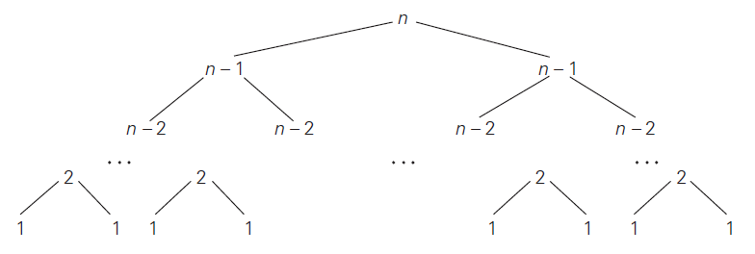


Slide 76
Algorithm TowerOfHanoi(n, Src, Aux, Dst)
if (n = 0) RETURN
Hanoi(n-1, Src, Dst, Aux)
Move disk n from Src to Dst
Hanoi(n-1, Aux, Src, Dst)
Input Size: n
Basic Operation : Move disk n from Src to Dst
C(n) = 2 C(n - 1) + 1, C(0) = 0
= 2^{n} - 1 ∈ Θ(2^{n})
Basic Operation : (n = 0)
C(n) = 2 C(n - 1) + 1, C(0) = 1
= 2^{n} + 2^{n} - 1 ∈ Θ(2^{n})

Slide 77
Algorithm TowerOfHanoi2(n, A, B, C)
if (n = 1)
Move disk n from A to C
RETURN
TowerOfHanoi2(n-1, A, C, B)
Move disk n from A to C
TowerOfHanoi2(n-1, B, A, C)
RETURN
Basic Operation : Move disk n from A to C
C(n) = 2 * C(n - 1) + 1, C(1) = 1
= 2^{n} - 1 ∈ Θ(2^{n})
Basic Operation : (n=1) i.e. the number of function calls
C(n) = 2 * C(n - 1) + 1, C(1) = 1
= 2^{n} - 1 ∈ Θ(2^{n})

Slide 78
Algorithm TowerOfHanoi3(n, A, B, C)
if (n = 0) RETURN
if (n>1) TowerOfHanoi3(n-1, A, C, B)
Move disk n from A to C
if (n>1) TowerOfHanoi3(n-1, B, A, C)
RETURN
Basic Operation : Move disk n from A to C
C(n) = 2 * C(n - 1) + 1, C(1) = 1
= 2^{n} - 1 ∈ Θ(2^{n})
Basic Operation : (n=0) i.e. the number of function calls
C(n) = 2 * C(n - 1) + 1, C(0) = C(1) = 1
= 2^{n} - 1 ∈ Θ(2^{n})

Slide 79

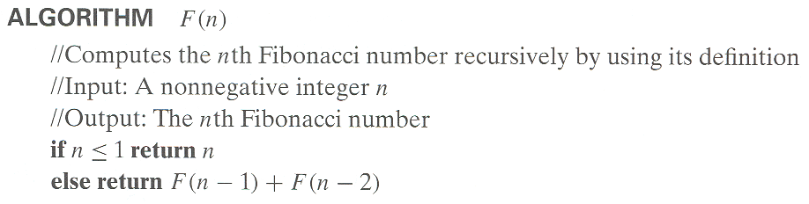
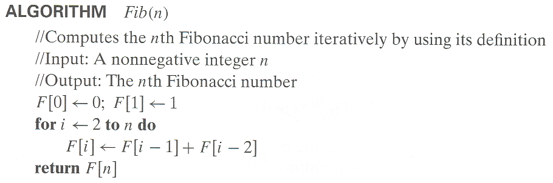

Slide 80
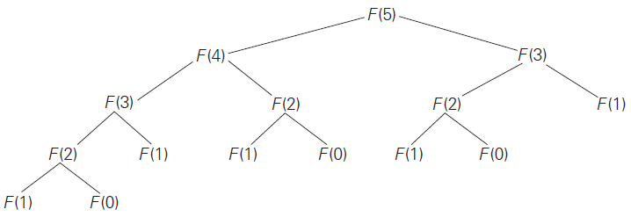

Slide 81








Slide 82
Algorithm: Fib1(n)
Input Size: n
Basic Operation : Addition
C(n) = 1+ C(n - 1) + C(n - 2), C(0) = C(1) = 0
≅ 1.6^{n} ∈ Θ(1.6^{n})
Note: On a hypothetical computer with 1 terahertz processor and one clock tick per operation, for n = 100, it takes about 8 years (∵ 1.6¹⁰⁰ ≅ 2⁶⁸ operations ≅ 2³ * 2²⁵ seconds).
Algorithm: Fib2(n)
Input Size: n
Basic Operation : Addition
C(n) = (n - 1) ∈ Θ(n)

Slide 83

Finding nth Fibonacci number:
Algorithm Fib3(n)
//
a = 0, b = 1
for i = 2 to n
c = a + b
a = b
b = c
return b
Algorithm Fib4(n)
//
f = //Closed-form formula
return f

Slide 84
Algorithm Foo(n)
sum ← 0
for i ← 1 to n
j ← 1
while(j ≤ n)
sum ← sum + k
j ← j * 2
return sum
Input Size: n
Basic Operation : sum ← sum + k
C(n) = ? ∈ Θ(?)

Slide 85
Algorithm Foo(n)
sum ← 0
i ← 1
while(i ≤ n)
for j ← 1 to n
sum ← sum + k
i ← i * 2
return sum
Input Size: n
Basic Operation : sum ← sum + k
C(n) = ? ∈ Θ(?)

Slide 86
Algorithm Foo(n)
sum ← 0
i ← 1
while(i ≤ n)
for j ← 1 to i
sum ← sum + k
i ← i * 2
return sum
Input Size: n
Basic Operation : sum ← sum + k
C(n) = ? ∈ Θ(?)

Slide 87
Algorithm Foo(n)
sum ← 0
i ← 1
while(i ≤ n)
for j ← 1 to i
for k ← 1 to n in steps of 2
sum ← sum + k
i ← i * 2
return sum
Input Size: n
Basic Operation : sum ← sum + k
C(n) = ? ∈ Θ(?)

Slide 88
Design. Analyse. Repeat!
</ Analysis Framework >

